Slide 1
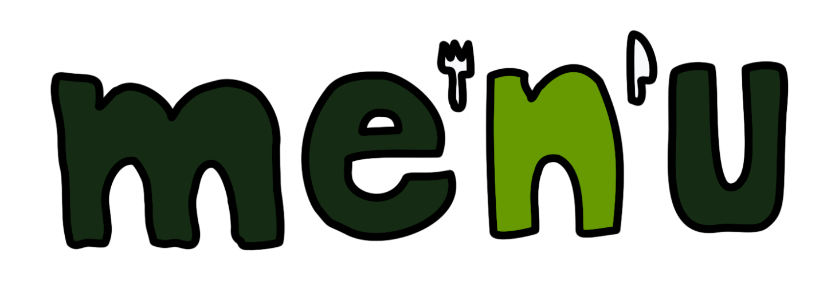
We deserve arrays • 15.12.2021 • Milestone 3

Slide 2
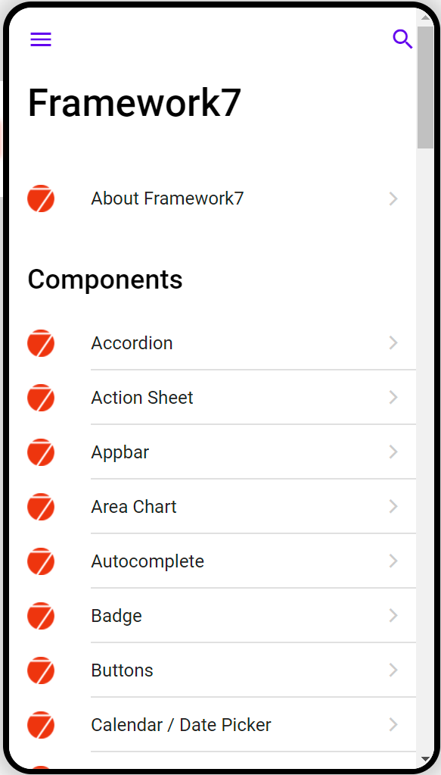
Framework 7:
After initial orientation relatively easy to use
Many pre-built components
Most components work for Android and iPhone
Me’N’U App:
Designed according to Material Design
Modular build
Responsive design
Notes:
Framework7: makes our lives easier and our app better
Decision for material design -> More familiar to us; higher market share in Germany
modular build -> clear and well structured code; easier to read as an outsider;

Slide 3
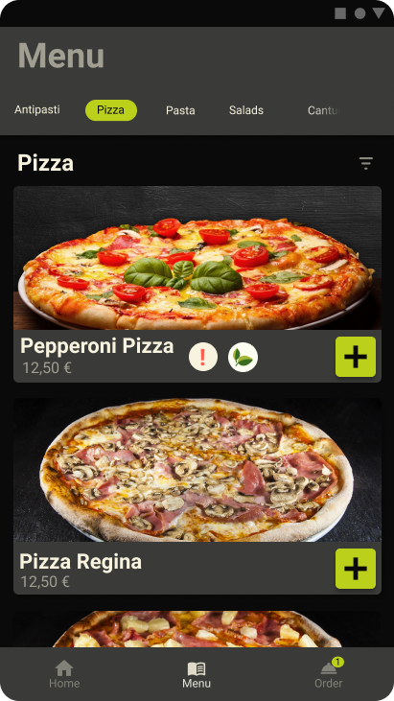
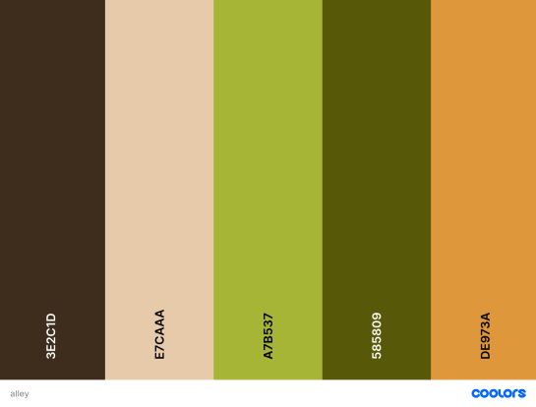
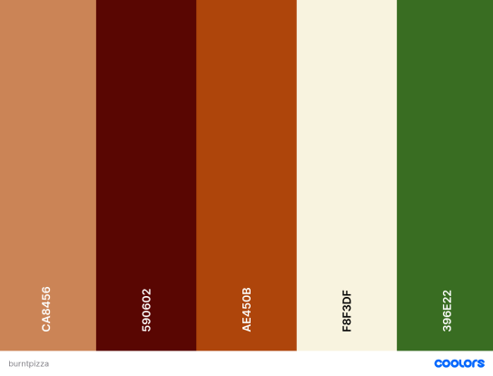
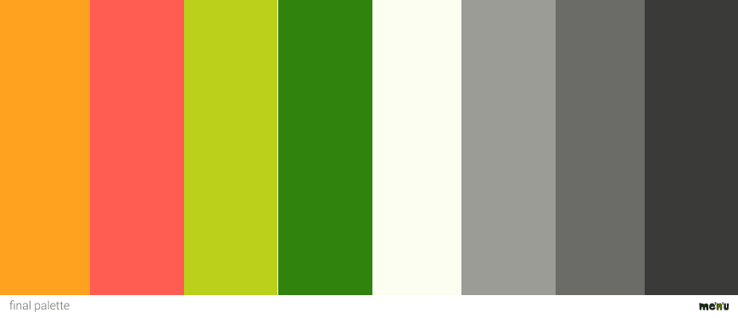
Styled Prototype
Figma
Coolors, Adobe Color wheel
Me’N’U App:
Food generated color schemes
Dark ui
Primary Colour + Framework7 preset dark mode

Slide 4
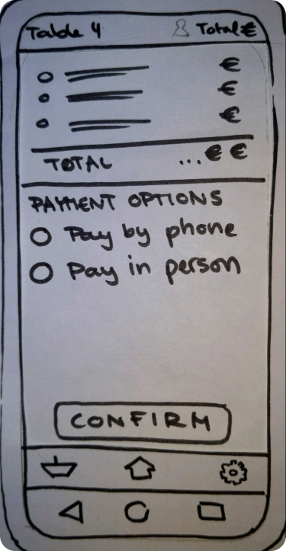
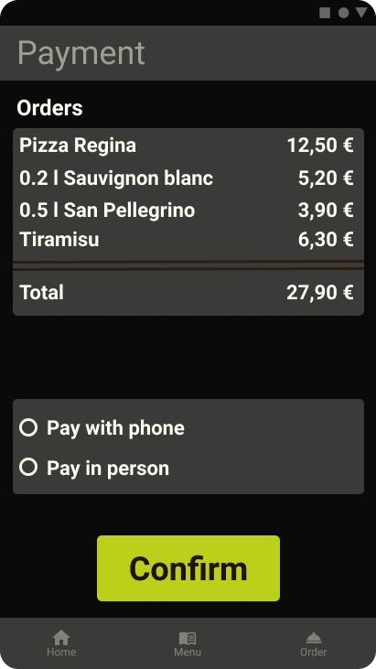
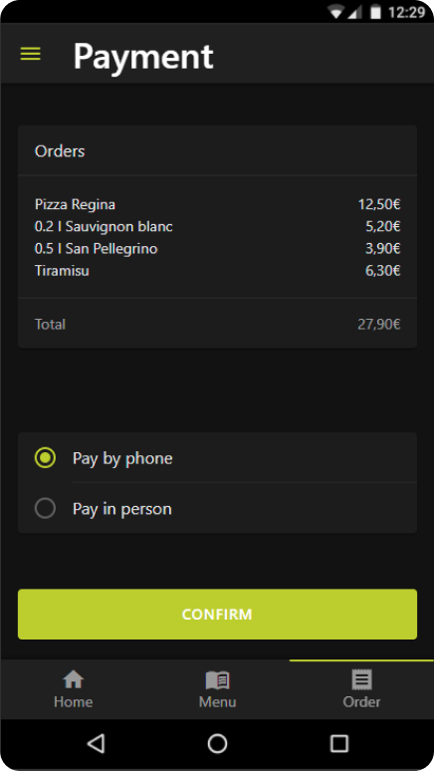
Design timeline:
Paper Prototype -> HiFi Prototype -> LoFi Web Prototype

Slide 5
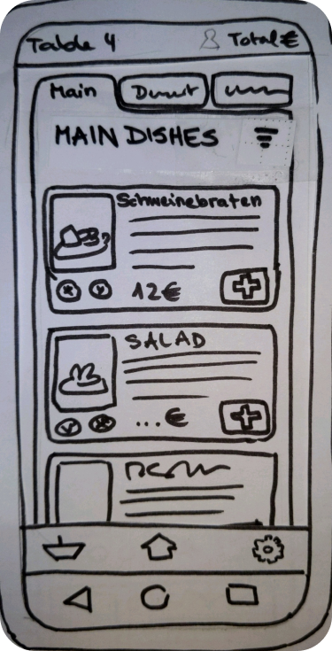
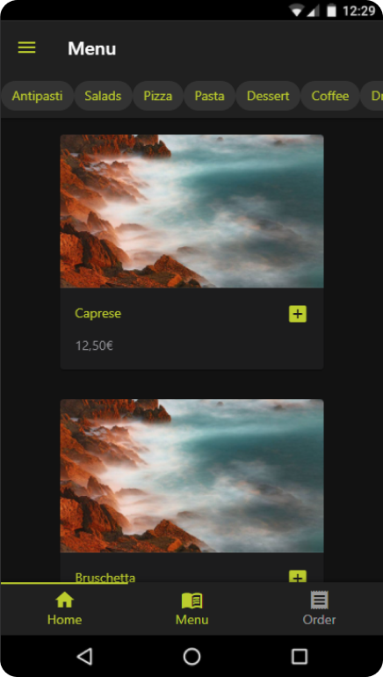
Design timeline:
Paper Prototype -> HiFi Prototype -> LoFi Web Prototype

Slide 6
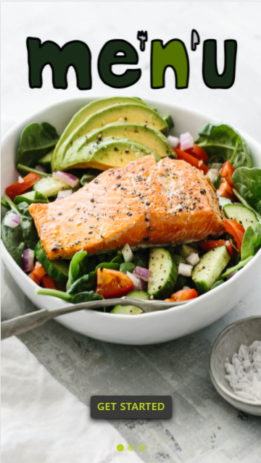
Prototype Live Demo

Slide 7
Qualitative Evaluation
User Tasks:
Getting Started
editing Preferences
Customise food
Call a waiter
Past and new orders
Order and pay
Do not disturb
Check Out
Subjects:
4 participants
1 female, 3 male
aged between 22 and 27
Prototype provided on mobile phone (2) or computer (2)
Three-step approach:
First Glance Testing
Scenario and User Tasks combined with additional questions
Holistic Experience

Slide 8
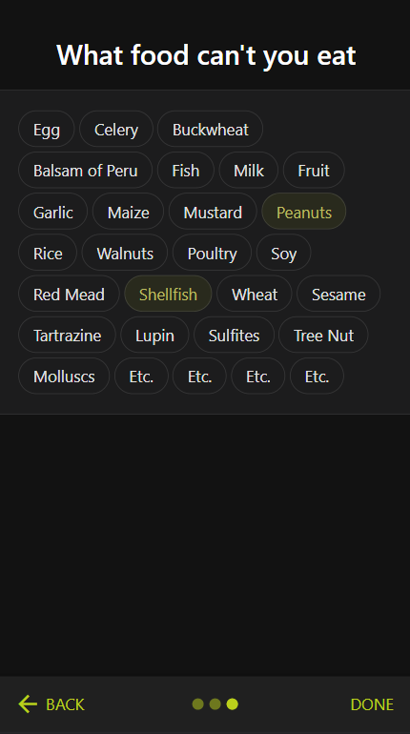
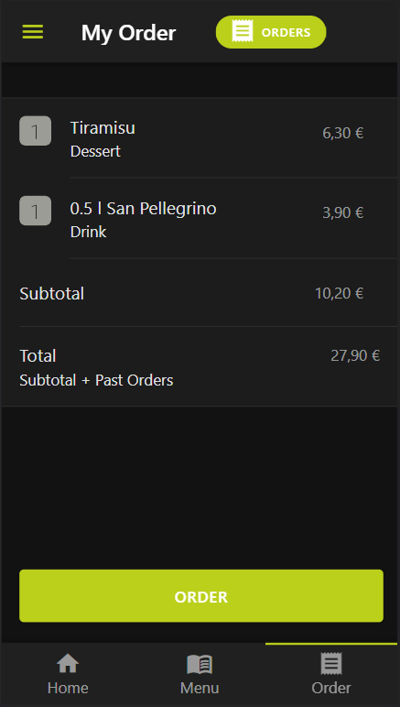
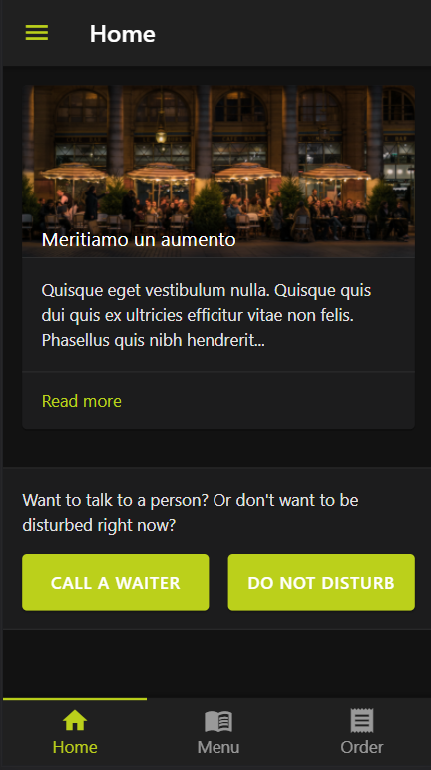
Results:
confirmations/feedback after actions
fixing up the Getting Started sequence
Past Orders

Slide 9
Discussion
Notes:
-past orders on same screen as orders

